Slide 1
Spearmans Rank
Statistical Analysis to show Relationship Strength.

Slide 2
Results from a survey looking investigating the price of items in relation to the shops distance from a major tourist attraction
Rank distance - Rank price

Slide 3
SPEARMAN’S RANK CORRELATION COEFFICIENT
It says …
It allows us to …
Compare the
RANK ORDER
of TWO Data Sets

Slide 4
The total of
6 x
Spearman’s Rank Correlation Coefficient
The DIFFERENCES between the RANKS assigned to each ‘price’ SQUARED
The Number of different ‘sites’
This example is based on a survey looking at price & distance

Slide 5
The Maths
The top line of the equation
d² (rank difference ²) = 285.5.
Multiplying this by 6 gives 1713.
Now for the bottom line of the equation.
n (the number of sites) =10.
n³ - n :1000 – 10 = 990
R = 1 - (1713/990)
R: 1 - 1.73 = -0.73
What does this R value of -0.73 mean?
The closer R is to +1 or -1, the stronger the likely correlation. Perfect positive correlation is +1 and a perfect negative correlation is -1. The R value of -0.73 suggests a fairly strong negative relationship.

Slide 6

What is it showing?
Total Agreement
Overall Neither
Agree or Disagree
Total Disagreement
r_{s} close to 1
r_{s} close to 0
r_{s} close to -1

Slide 7
The significance of the relationship!
  The R value of -0.73 must be looked up on the Spearman Rank significance table.
  'degrees of freedom' : This is the number of pairs in your sample minus 2 (n-2).
  8 (10 - 2).
  Using the r value (y axis) the degrees of freedom value (x axis)plot the position of the graph (next page).

Slide 8
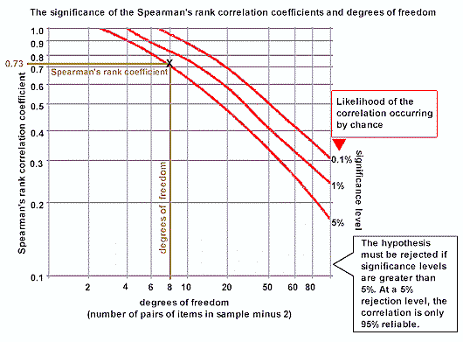

Slide 9
Tasks
Work through the example on p.636 (Waugh), fill in the table & check that you understand how each column is calculated.
Complete the tasks on the next 2 slides and

Slide 10
A student Surveyed the ages, in years, and the prices, in £’s, of ten second hand cars of a particular type, in a local paper and obtained the data in the table below:
What can you say about the relationship between the age and price of cars …
Age, years | 6 | 2 | 9 | 5 | 13 | 4 | 7 | 8 | 3 | 10
Price, £’s | 2790 | 5990 | 850 | 3100 | 650 | 3350 | 3790 | 1350 | 4590 | 990
Data |  | Ranks |  | Differences
Age | Price | Age | Price | d | d²
Use the graph (p.637) to determine the significance of the relationship.

Slide 11
A student has been shown photographs of eight different people and asked to estimate their ages …
The results are shown …
Actual age in years | 54 | 88 | 22 | 70 | 30 | 15 | 47 | 6
Estimated Age | 45 | 70 | 35 | 62 | 24 | 19 | 56 | 11
Data |  | Ranks |  | Differences
Actual | Estimate | Actual | Estimate | d | d²
What is the significance of the relationship?

